Slide 1
Boosting for transfer learning with multiple sources
Yijun Liu
Department of Computer Science
University of Wyoming
Pan, S. J., & Yang, Q. (2010). A survey on transfer learning. IEEE Transactions on knowledge and data engineering, 22(10), 1345-1359.
Yao, Y., & Doretto, G. (2010, June). Boosting for transfer learning with multiple sources. In 2010 IEEE Computer Society Conference on Computer Vision and Pattern Recognition (pp. 1855-1862). IEEE.

Slide 2
Overview of Transfer Learning
Introduction
Related Work
Boosting for transfer learning with multiple sources
Experiments and Conclusion

Slide 3
Traditional ML vs. TL
Traditional ML in
multiple domains
Transfer of learning
across domains
training items
test items
test items
training items
Humans can learn in many domains.
Humans can also transfer from one domain to other domains.

Slide 4
Traditional ML vs. TL
training items
training items
Learning System
Learning System
Learning System
Learning System
Knowledge

Slide 5
Transfer Learning?
Transfer Learning (TL):
The ability of a system to recognize and apply knowledge and skills learned in previous tasks to novel tasks (in new domains)
It is motivated by human learning. People can often transfer knowledge learnt previously to novel situations
Chess Checkers
Mathematics Computer Science
Table Tennis Tennis
Pan, S. J., & Yang, Q. (2010). A survey on transfer learning. IEEE Transactions on knowledge and data engineering, 22(10), 1345-1359.

Slide 6

Notation
Domain:
It consists of two components: A feature space , a marginal distribution
In general, if two domains are different, then they may have different feature spaces
or different marginal distributions.
Task:
Given a specific domain and label space , for each in the domain, to
predict its corresponding label
In general, if two tasks are different, then they may have different label spaces or
different conditional distributions.

Slide 7
Notation
For simplicity, we only consider at most two domains and two tasks.
Source domain:
Task in the source domain:
Target domain:
Task in the target domain

Slide 8
Why Transfer Learning?
In some domains, labeled data are in short supply.
In some domains, the calibration effort is very expensive.
In some domains, the learning process is time consuming.
How to extract knowledge learnt from related domains to help learning in a target domain with a few labeled data?
How to extract knowledge learnt from related domains to speed up learning in a target domain?
Transfer learning techniques may help!

Slide 9
Settings of Transfer Learning
Transfer learning settings | Labeled data in a source domain | Labeled data in a target domain | Tasks
Inductive Transfer Learning | × | √ | Classification Regression …
 | √ | √
Transductive Transfer Learning | √ | × | Classification Regression …
Unsupervised Transfer Learning | × | × | Clustering …

Slide 10
Self-taught Learning
An overview of
various settings of
transfer learning
Case 1
No labeled data in a source domain
Inductive Transfer Learning
Labeled data are available in a source domain
Labeled data are available in a target domain
Source and target tasks are learnt simultaneously
Multi-task Learning
Case 2
Transfer Learning
Labeled data are available only in a source domain
Assumption: different domains but single task
Transductive Transfer Learning
Domain Adaptation
No labeled data in both source and target domain
Assumption: single domain and single task
Pan, S. J., & Yang, Q. (2010). A survey on transfer learning. IEEE Transactions on knowledge and data engineering, 22(10), 1345-1359.
Unsupervised Transfer Learning
Sample Selection Bias /Covariance Shift

Slide 11
Settings of Transfer Learning
Transfer learning approaches | Description
Instance-transfer | To re-weight some labeled data in a source domain for use in the target domain
Feature-representation-transfer | Find a “good” feature representation that reduces difference between a source and a target domain or minimizes error of models
Model-transfer | Discover shared parameters or priors of models between a source domain and a target domain
Relational-knowledge-transfer | Build mapping of relational knowledge between a source domain and a target domain.

Slide 12
Introduction
One would save time if he/she could leverage useful information from existing annotated data and/or classifiers of old object categories.
However, brute force transferring in case of weak relationships may lead to performance deterioration of the resulting classifier. This is known as negative transfer.
TrAdaBoost relies only on one source, and therefore is intrinsically vulnerable to negative transfer. This work formally states the problem of transfer learning from multiple sources to improve the training of a target classifier
This paper proposed a boosting method for transfer learning with multiple sources
Yao, Y., & Doretto, G. (2010, June). Boosting for transfer learning with multiple sources. In 2010 IEEE Computer Society Conference on Computer Vision and Pattern Recognition (pp. 1855-1862). IEEE

Slide 13
Related Work
Instance-transfer, feature-representation-transfer, parameter-transfer , and relational knowledge-transfer are proposed [1].
Support vector machines (SVM) have been modified for transfer learning. In [2] an SVM is derived by adjusting existing classifiers according to the target data.
Some related work has extended boosting for multi-task learning [3] and on-line incremental learning [4].
Although SVM-based transfer learning has been extended to leverage knowledge from more than one source, to the best of the knowledge of the authors, this is the first work that extends boosting-based transfer learning to multiple sources.
Pan, S. J., & Yang, Q. (2010). A survey on transfer learning. IEEE Transactions on knowledge and data engineering, 22(10), 1345-1359.
J. Yang, R. Yan, and A. G. Hauptmann. Cross-domain video concept detection using adaptive SVMs. In ACM Multimedia, 2007.
X. Wang, C. Zhang, and Z. Zhang. Boosted multi-task learning for face verification with applications to web image and video search. In CVPR, 2009.
H. Grabner and H. Bischof. On-line boosting and vision. In CVPR, pages 260–267, New York, NY, Jun. 2006.

Slide 14



Problem statement
Formally, a domain D is made of a feature space , and a marginal probability distribution P(X), where X = {x₁,…x_{n}}; x_{i} ∈ . A task is made of a label space Y = {+1, -1}, and a boolean function f : X Y. Learning the task T for the domain D.
Let us now indicate with a target domain for which we would like to learn the target task .
from the target training data
Let us also indicate with a source domain, and with a source task, for which we have available the source training data
Improving the learning of the target classifier function by exploiting the knowledge of the source task , in the source domain .

Slide 15
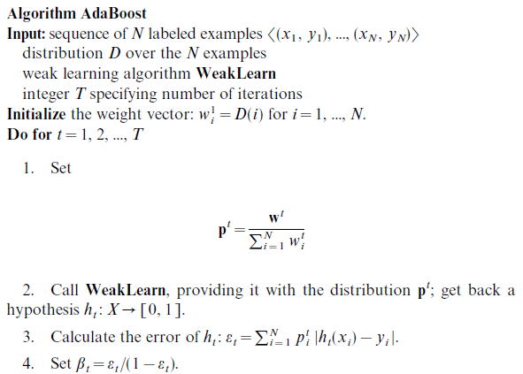
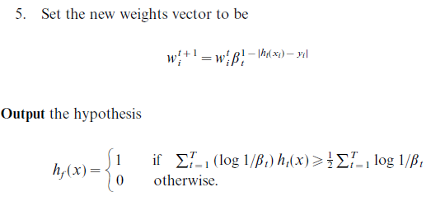
AdaBoost
Freund, Yoav, and Robert E. Schapire. "A decision-theoretic generalization of on-line learning and an application to boosting." Journal of computer and system sciences 55.1 (1997): 119-139.

Slide 16
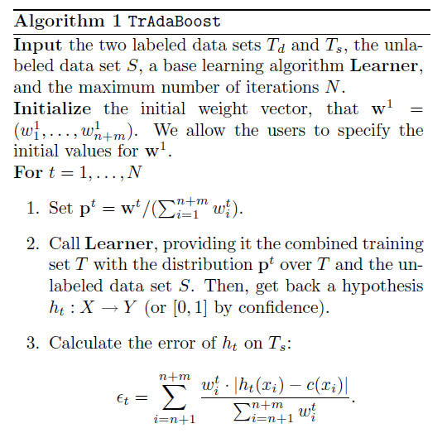
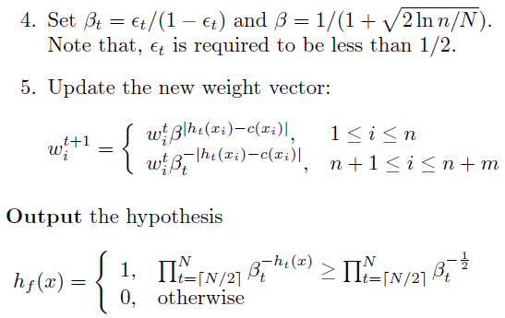
TrAdaBoost
W. Dai, Q. Yang, G. Xue, and Y. Yu. Boosting for transfer learning. In Int’l Conf. on Machine Learning, Corvallis, OR, 2007.

Slide 17
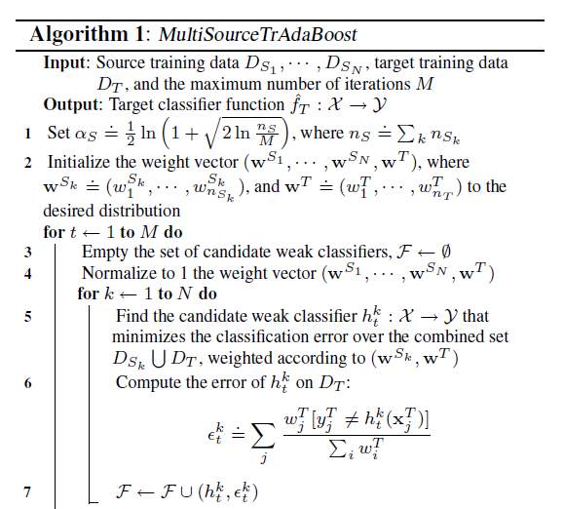
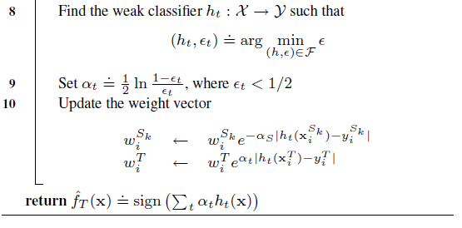
TrAdaBoost with multiple sources (MultiSourceTrAdaBoost)

Slide 18
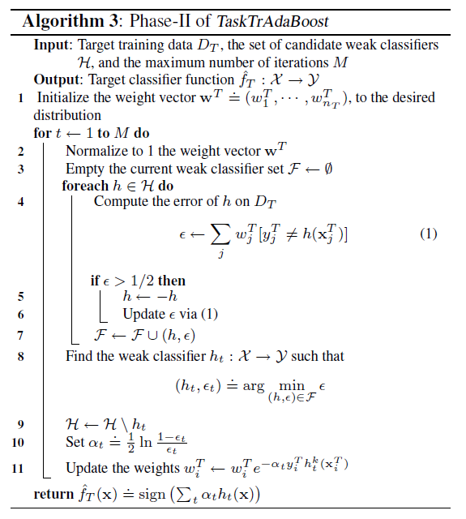
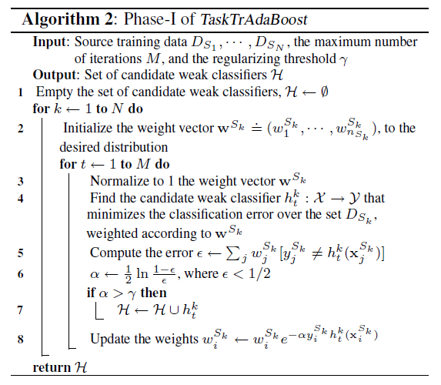
TrAdaBoost with multiple sources (TaskTrAdaBoost)

Slide 19
Experiments
Data sets
For object category recognition, we have used the Caltech 256 data set, which contains 256 object categories. Among them, we have used the 136 categories that have more than 100 samples. We have also used the background data set, collected via the Google image search engine, along with the remaining categories as our augmented background data set.

Slide 20
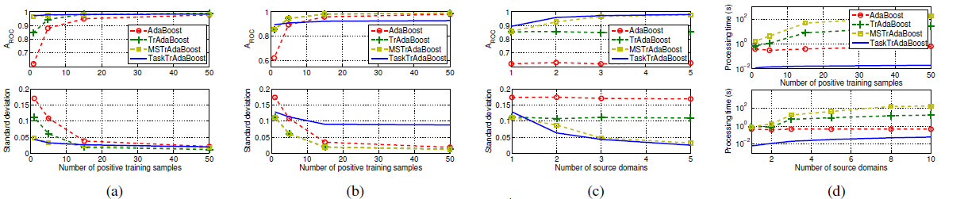
Result

Slide 21
Conclusion
This work extends the boosting framework for inductive transfer learning when knowledge from multiple sources is available to help training a target classifier. Considering multiple sources directly addresses the problem of negative transfer because the chance to import knowledge from a source related to the target increases significantly.
MultiSourceTrAdaBoost, an instance-transfer approach, and TaskTrAdaBoost, a parameter-transfer (or more specifically a task-transfer) approach, are introduced.

Slide 22
Thank you

